Slide 1

Detect the disrupted brain connectivity in type-II diabetes patients
MATH 5470 project
WEI, Yue & XIE, Weiyan

Slide 2
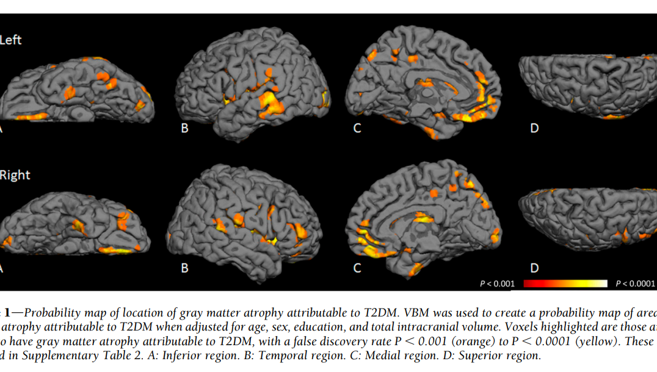
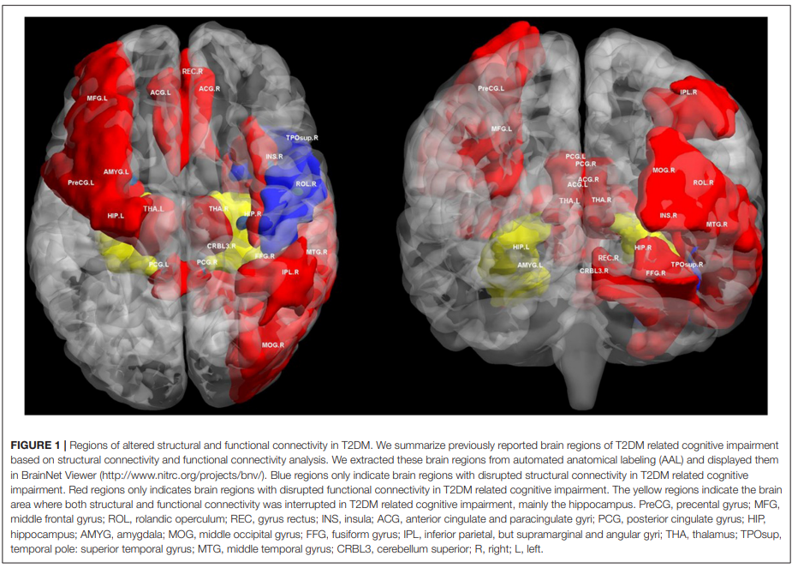
Introduction
T2DM and disrupted brain
Type-II diabetes mellitus (T2DM) – a metabolic disorder characterized by hyperglycemia
High blood glucose levels may damage brain and adversely affects cognition
T2DM patient are highly susceptible to several forms of cognitive impairments (e.g dementia)
Previous research revealed structural brain atrophy and changes of functional connectivity in T2DM patients correlated with the decrease of their cognitive impairments
When the brain damage start with the course of disease?

Slide 3

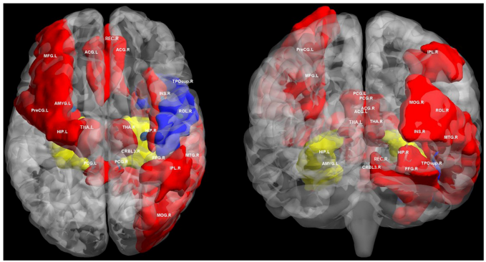
Introduction
Gaps:
For T2DM patient without clinical cognitive impairment, does the changes in diabetes brain distinguishable from healthy brain? Limited works with no-MCI patients.
Which part in the structural brain network is most affect? Whether local gray matter volume or structural brain connections can better distinguish the diabetes brain? Very limited studied had focus on disrupted structural connectivity in T2DM
How does the brain damage progressively develop with the course of disease? Can we build a model to predict the onset of T2DM based on current brain damage (so doctors can prevent brain damage in advance)?

Slide 4

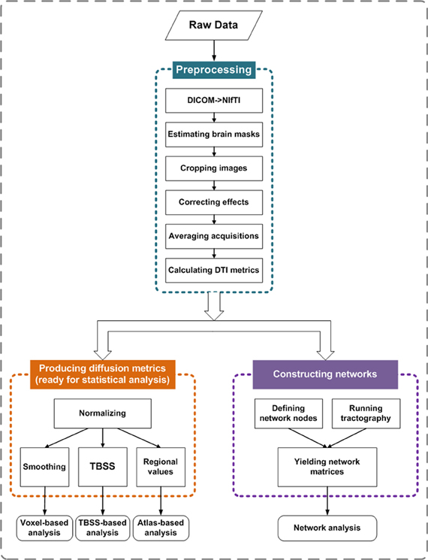
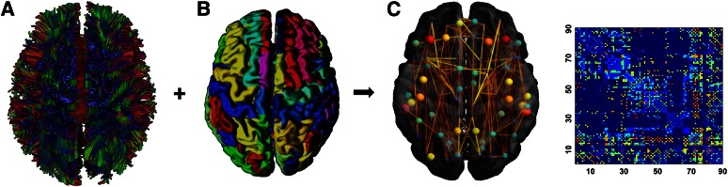
Data acquisition
DTI and structural network construction
Diffusion tensor imaging (DTI) is a promising method for characterizing microstructural changes or differences with neuropathology.
Fractional Anisotropy (FA) - DTI scalar sensitive to microstructural changes
PANDA pipeline:
Notes:
From these multiple DWI measurements, regression or nonlinear techniques can be used to estimate the 3 × 3 tensor field that describes the preferred magnitude and orientation of the self-diffusion properties of water (Figure 3.1.4(A)). The diffusion tensor, D, is positive and symmetric, therefore it only has six unique values (i.e., D_{xy} = D_{yx}, D_{xz} = D_{zx} and D_{yz} = D_{zy}).
The preferred diffusion magnitude and direction are found from decomposition of the eigenvalues and eigenvectors for the diffusion tensor (D) in each image voxel.

Slide 5
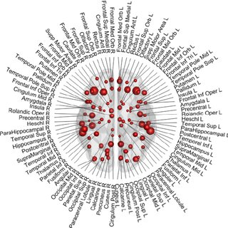
Data structure (X: For each participant)
(1) 8100 Brain structural network feature:
Pairwise connection between AAL90 brain regions
Weighted by Fractional anisotropy (FA)
In total: 90*90=8100 connections
(2) 180 Brain structural regional feature:
90 ROI surface size (how many voxels ended with fiber tracks)
90 ROI voxel size (how many voxels in each ROI)
Voxel is a volume unit in MRI scanning
*This is a dataset collected by The First Affiliated Hospital of Guangzhou University of Chinese Medicine, which co-worked with WEI Yue, we have one under reviewing paper on this dataset, not published yet.
AAL-90

Slide 6
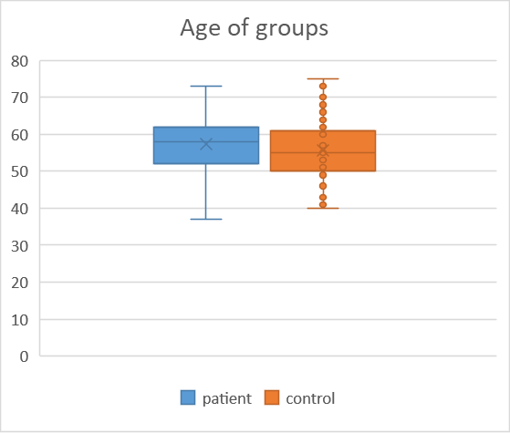
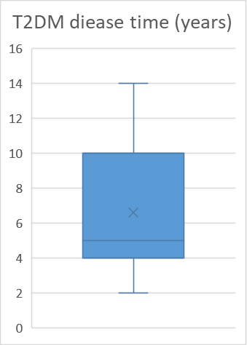
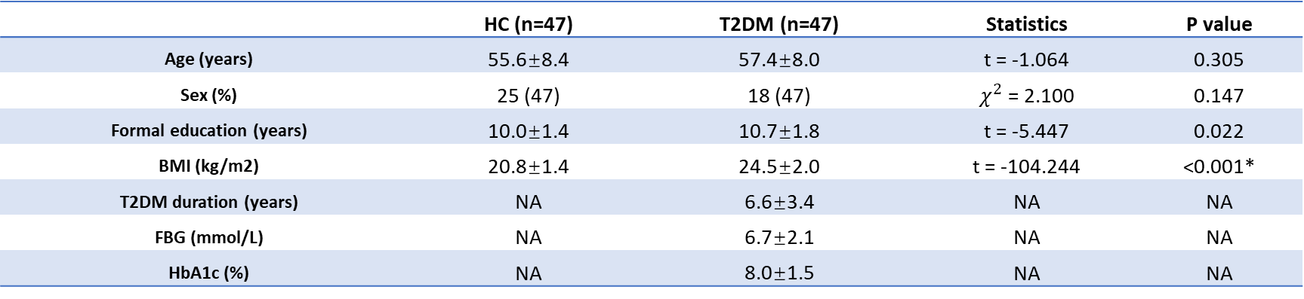
Data structure (Y: participants)
94 Subject with groups label :
47 Patients (diagnosed as T2DM without CI: cognitive impairment)
47 Controls (healthy matched group with age and gender)
47 patient with clinical course data:
T2DM duration (time course of disease in years)
 | HC (n=47) | T2DM (n=47) | Statistics | P value
Age (years) | 55.6±8.4 | 57.4±8.0 | t = -1.064 | 0.305
Sex (%) | 25 (47) | 18 (47) | $χ^{2}$ = 2.100 | 0.147
Formal education (years) | 10.0±1.4 | 10.7±1.8 | t = -5.447 | 0.022
BMI (kg/m2) | 20.8±1.4 | 24.5±2.0 | t = -104.244 | <0.001*
T2DM duration (years) | NA | 6.6±3.4 | NA | NA
FBG (mmol/L) | NA | 6.7±2.1 | NA | NA
HbA1c (%) | NA | 8.0±1.5 | NA | NA

Slide 7
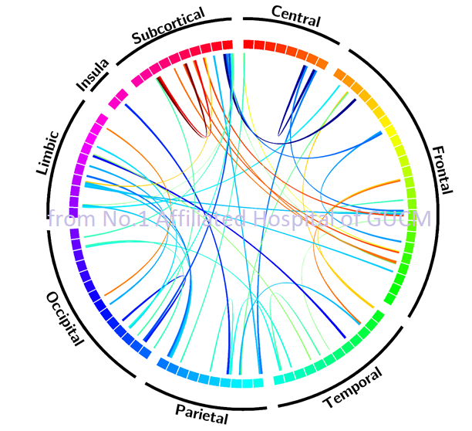
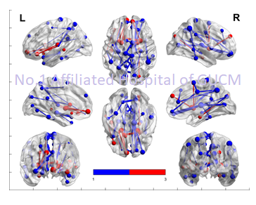
Data preprocessing
No significant age & gender difference was revealed for two group (patient/control)
The education level of patient group is significantly higher than control group
Compare FA difference between group with permutation test (5000 trials) and FDR correction (p<0.025), education was added as covariates
Following showed 47 connections with significant difference between the two group
Permutation test with FWA correction:
Red – patient > control, p<0.025
Blue –patient < control, p<0.025

Slide 8
Task 1 - Classification Model: Distinguishing Type-II Diabetes Patients and Healthy People
Our first task is to use the brain connectivity features for predicting whether the person is a patient with type-II diabetes. The most significant challenge here is that the number of connectivity features (8,100) is much larger than the sample size (94);
To evaluate the fitted model's performance in practical use, we apply the stratified K-fold cross-validation strategy;
Evaluation Metrics: Accuracy, Precision, Recall, and F1-Score.

Slide 9
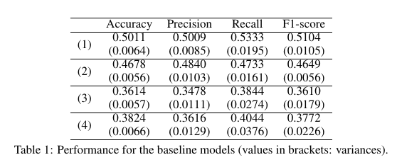
Baseline Building
We first build some baseline models using the logistic regression. The baseline models use the data:
(1) All 8,100 brain connectivity features;
(2) 90 surface size features;
(3) 90 voxel size features;
(4) 90 surface size features+90 voxel size features.
Structural connection feature: provides more useful information
Better than all other regional features in predicting the diabetic brain!

Slide 10
Feature Selection with Permutation Test
Test whether the difference in means between two groups is changed significantly when the group labels are randomly reassigned;
Null hypothesis: the data drawn from the control group is from the same distribution as the data drawn from the patient group;
We reject the null hypothesis for each brain connectivity feature at the significance level of 0.05;
Under the significance level, most of the connectivity features do not show significant differences between the control and patient groups, and the null hypothesis is rejected for only 94 of the 8,100 features (since the original matrix is symmetrical, those half of the features was redundant, thus left 47 feature).

Slide 11
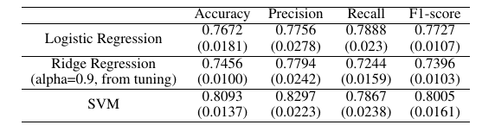

Model Performance with the 47 Brain Connectivity Features
Baseline
47 permutation screened connections:
Better than all baseline models in predicting the diabetic brain (with 74.5% Acc)!

Slide 12
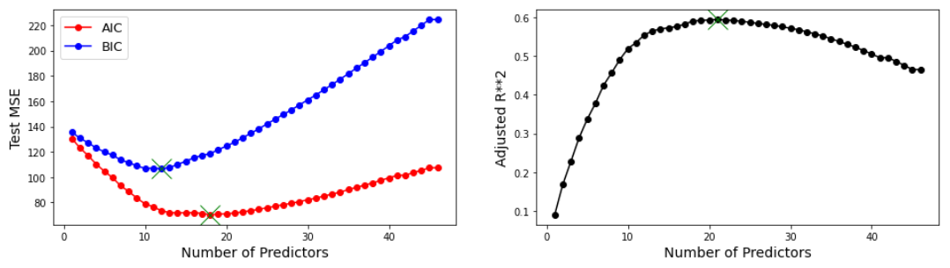
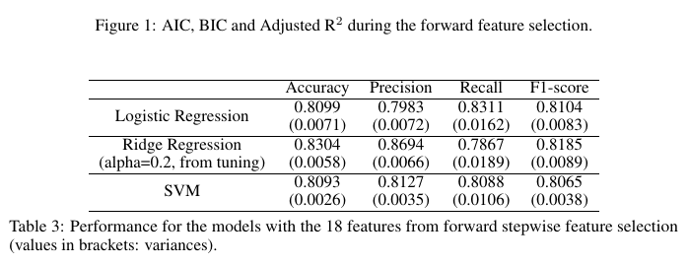
Forward Stepwise Feature Selection
18 best connections:
Features best characterized the diabetic brain (with 83% Acc)!

Slide 13
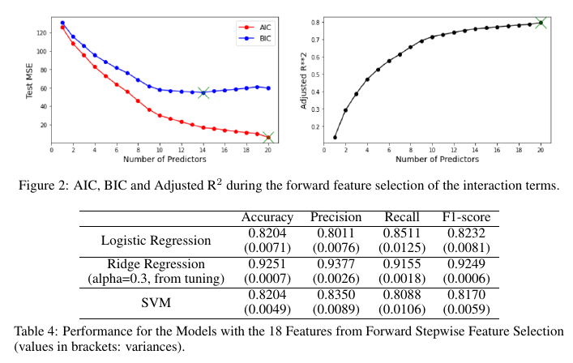
Adding some Interaction Terms
The previous study has pointed out that different brain regions can act synergistically for the occurrence of some diseases;
i.e., alterations in the connections of one pair of brain regions do not necessarily lead to disease, but when the connections of two brain regions are altered at the same time, the lesions can occur;
18 selected features → 153 second-order interaction terms.
18 best connections + 14 interaction terms:
Best model in predicting the diabetic brain (with 92.5% Acc)!!

Slide 14
Task 2 - Regression Model: Predicting Disease Duration of Type-II Diabetes Patients
To further explore the usefulness of brain connectivity data to help doctors in the treatment of the patients, we try to use the brain connectivity features to predict the duration of the disease (unit: year);
Since we have only 47 data instances for the type-II diabetes patients, for evaluating the performance of built prediction models, we apply the Leave-One-Out (LOO) Cross-Validation strategy;
Evaluation Metric: Root Mean Square Error (RMSE).

Slide 15
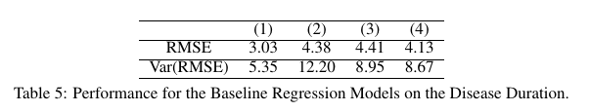
Baseline Building
We first build some baseline models using linear regression.
The baseline models use the data:
All 8,100 brain connectivity features;
90 surface size features;
90 voxel size features;
90 surface size features+90 voxel size features.
The connectivity between brain regions provides much more useful information for predicting the disease duration.
The performance of all these baseline models is not that satisfactory, especially the high variance of RMSE indicates the model prediction is not stable.

Slide 16

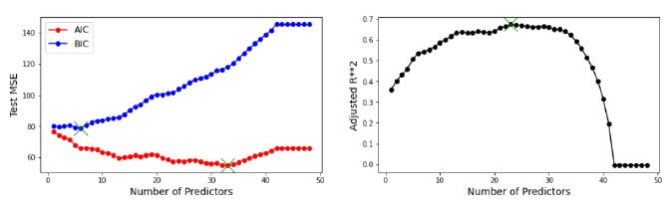
Data Transformation and Feature Selection
Data Transformation:
Since the distribution of the disease duration in the dataset is far away from the normal distribution (with excess kurtosis=-0.739 and skewness=0.529) , the model fitted directly on the duration has high risk of breaking the normality assumption of the linear regression model.
Square Root Transformation:
Feature Selection:
Permutation test + Forward Feature Selection → choose number of features = 6
RMSE=1.94
Var(RMSE)=2.13

Slide 17
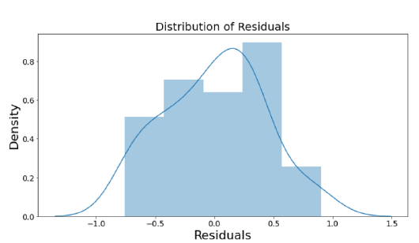
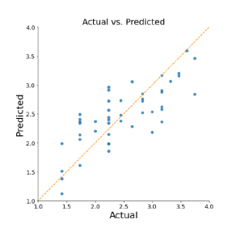
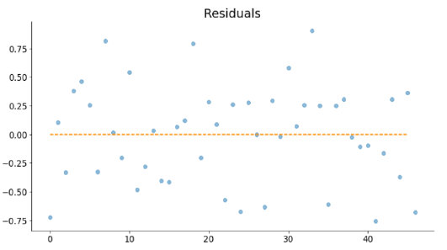
Testing Linear Regression Assumptions
Linear relationship;
(2) Multivariate normality
Anderson-Darling test - p-value = 0.3659 ;
(3) No or little multicollinearity;
Highest absolute correlation value = 0.12 ;
(4) No auto-correlation
Durbin-Watson test - test value = 2.19 ;
(5) Homoscedasticity.

Slide 18
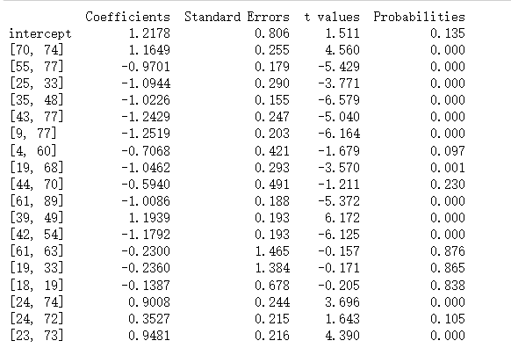
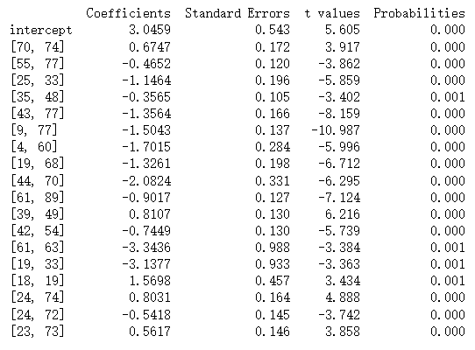
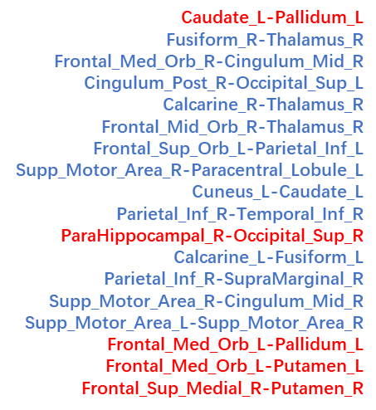
Discussion
Connection features can distinguish diabetic brain with 92.5% accuracy in no cognitive impairment(CI) T2DM patients
18 most important connections: brain connection related to CI in previous works
Logistic regression:
Ridge regression:
***
***
***
***
***

Slide 19
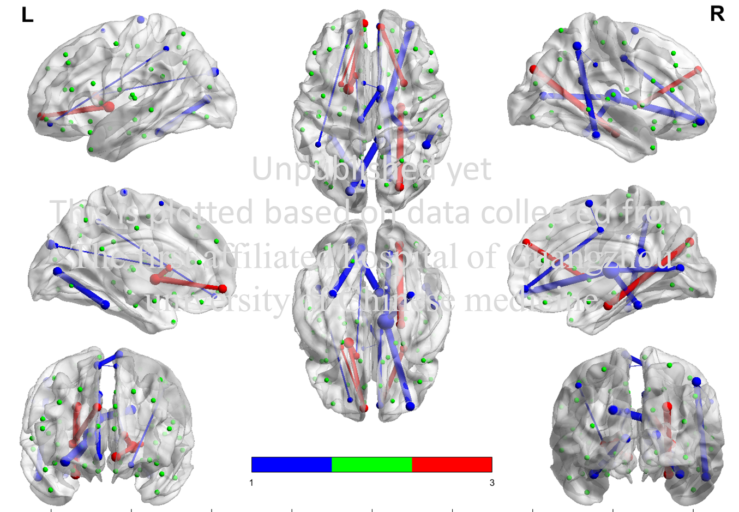
Discussion
Connection features can distinguish diabetic brain with 92.5% accuracy in no cognitive impairment(CI) T2DM patients
This is important evidences suggesting that brain changes was detectable before the CI
Earlier detection and earlier prevention
Brain imaging scans shall be included in T2DM regular checks to better prevent brain damages that lead to MCI or even AD

Slide 20
Discussion
We built a model with connection features to predict onset with error ±1.9 years
the performance of connectivity features is still better than regional features!
Structural connections based on white matter fiber tracks is more sensitive to the chronic hyperglycemia and time course of T2DM
The brain damage seems to be developed progressively based on the duration of T2DM (in years)
Recommended to check the brain connections in 1-2 years to access the status of brain damage of T2DM patient for better CI prevention
Future work: examine the model with patients with CI/ compare the disease progressive changes

Slide 21
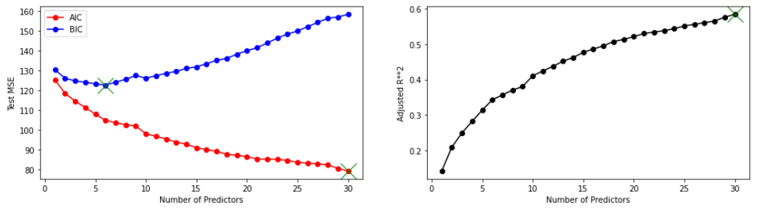
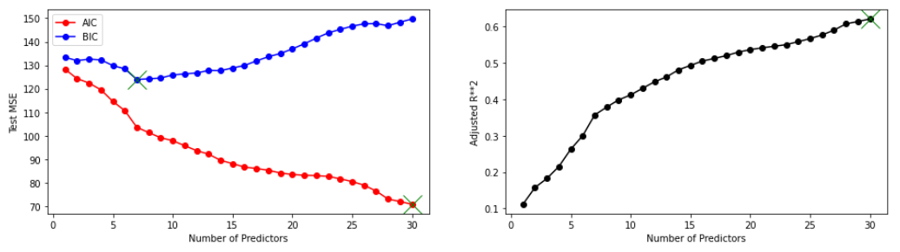
Discussion
Connection features outperform regional features in baseline model
This model does not penalized the model size…
## Surface Size with Feature Selection
## Voxel Size with Feature Selection
 | Accuracy Mean Variance | Precision Mean Variance | Recall Mean Variance | F1 Mean Variance
N=6 | 0.7766 | 0.8109 | 0.7733 | 0.7627
 | 0.0026 | 0.0100 | 0.0360 | 0.0094
N=30 | 0.7860 | 0.7915 | 0.8111 | 0.7914
 | 0.0063 | 0.0091 | 0.0131 | 0.0051
N=90 | 0.4678 | 0.4841 | 0.4733 | 0.4649
 | 0.0057 | 0.0103 | 0.0161 | 0.0056
 | Accuracy Mean Variance | Precision Mean Variance | Recall Mean Variance | F1 Mean Variance
N=7 | 0.7766 | 0.7694 | 0.8089 | 0.7812
 | 0.0015 | 0.0045 | 0.0106 | 0.0019
N=30 | 0.6801 | 0.6950 | 0.6978 | 0.6882
 | 0.0127 | 0.0262 | 0.0086 | 0.0111
N=90 | 0.3614 | 0.3479 | 0.3844 | 0.3611
 | 0.0057 | 0.0111 | 0.0274 | 0.0179

Slide 22
Discussion
Connection features outperform regional features in baseline model
This model does not penalized the model size…
With feature selection the performance of connectivity features is still better than regional features!
Same applies to the prediction on duration of T2DM
Structural connections based on white matter fiber tracks can better distinguish the diabetic brain than regional gray matter information
Connections disruption seems to be more sensitive to the hyperglycemia

Slide 23
Conclusion
Characterized diabetic brain even before the cognitive impairment!
→ Can distinguish diabetic brain from healthy brain with 92.5% accuracy
Structural connections based on white matter fiber tracks can better distinguish the diabetic brain than regional gray matter information
Can better distinguish T2DM
Can better predict the duration of T2DM
The brain damage developed progressively based on the duration of T2DM
→ can predict onset of T2DM using structural scans with error ±1.9 years

Slide 24
Thank you !!
Great thanks to all the participants joined this study!
Great thanks to Dr Liang Yi from the first affiliated hospital of Guangzhou university of Chinese medicine!
Q & A~

